Slide 1
Tiktok Data Story
File created on: 4/11/2025 5:52:30 PM

Slide 2
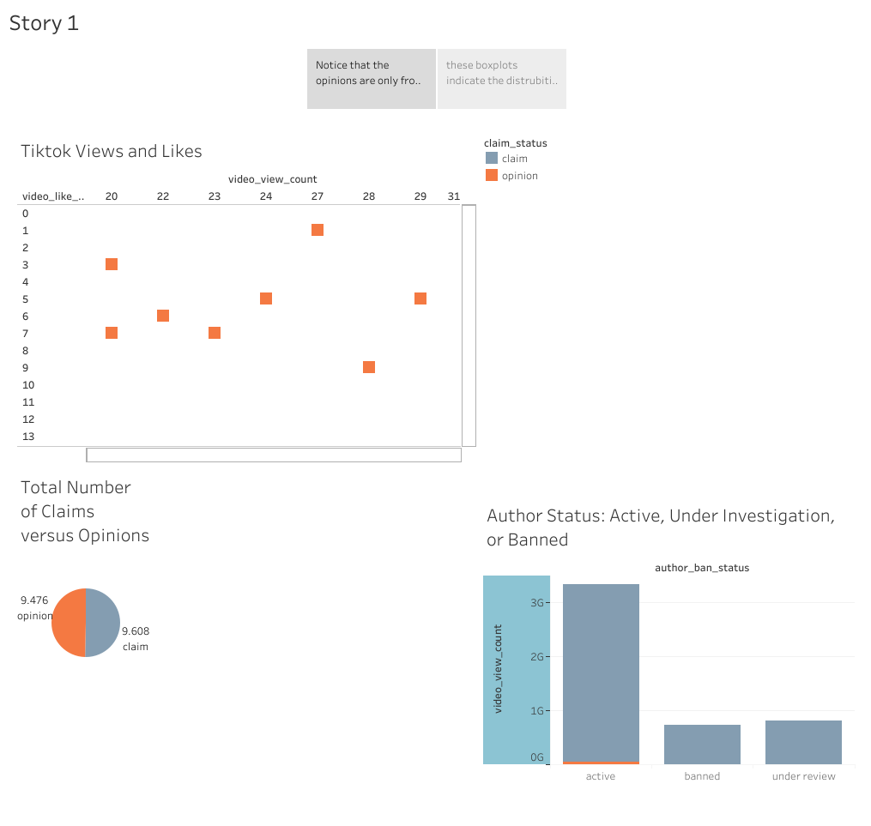

Slide 3
